Slide 1
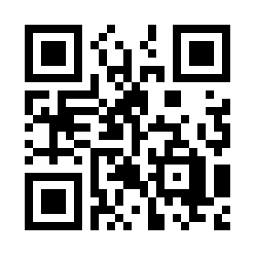


Introduction to Web Application (More) Quiz
https://bit.ly/3Dr60vG

